Slide 1
Oops Concepts in java
Presented By:
Suman Anand
Emp ID: 185861

Slide 2
These are the main OOPs Concepts in Java
Encapsulation
Inheritance
Polymorphism

Slide 3
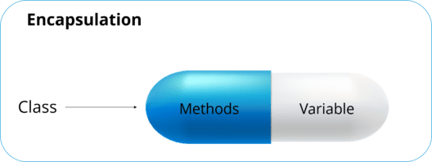
Encapsulation
“To Hide” details of structure and implementation.
Also referred to as “Information Hiding.”

Slide 4


Inheritance
Basic TV
Smart TV
Smart TV’s are inherited from basic TV which apart from multimedia functionality allows us to do more like streaming video contents from Internet.
Smart TV’s are “inherited” from Basic TV for two reasons:
To make enhancement and/or
To do alteration

Slide 5
Polymorphism
Poly mean “Many” and Morph mean “Forms”.
It is the capability of method to do different things based on the object used for invoking method.

Slide 6
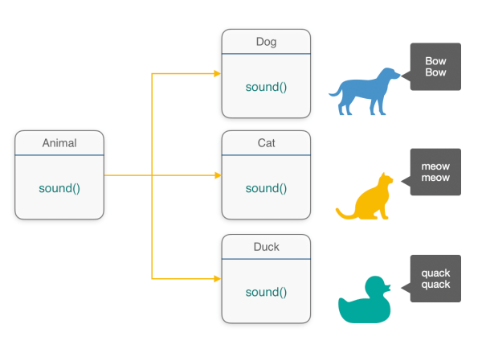
Polymorphism is implemented in 2 ways:
Method overloading
Method Overriding

Slide 7
Take Away:
Encapsulation is hiding of information
Inheritance allow creation of hierarchical classification.
Advantage of Inheritance is reusability of code.
Polymorphism means “Many Forms”.
Polymorphism can be implemented by method overloading/ method overriding.

Slide 8
Thank You

